Slide 1
Inheritance
Vu Tuan Hai

Slide 2
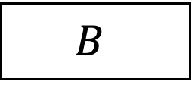
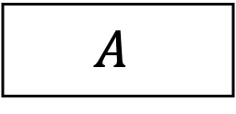
Relationships (1/4)
1-1
1-N
N-N
Generalization
~
$$A$$
$$B$$
???
Wife
Husband
has
Country
Capital

Slide 3
Relationships (2/4)
New notation
1-1
1-N
N-N
Generalization
~
$$A$$
$$B$$
has
Employee
Company
has
Class
Student

Slide 4
Relationships (3/4)
New notation
1-1
1-N
N-N
Generalization
~
$$A$$
$$B$$
has
Doctor
Patient
follow
love
Boy
Girl

Slide 5
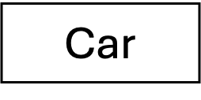
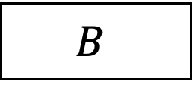
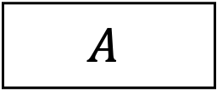
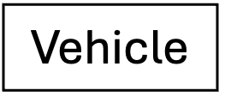
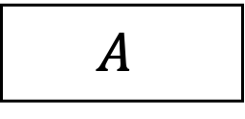
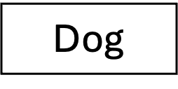
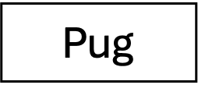
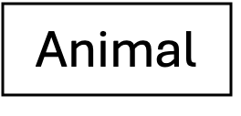
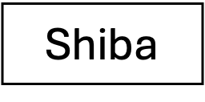
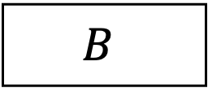
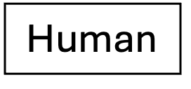
Relationships (4/4)
1-1
1-N
N-N
Generalization
D-level tree
Animal
Vehicle is the generalization version of car
NOT allowed
$$A$$
Vehicle
Dog
Human
$$A$$
~
New notation
$$B$$
Car
Shiba
Pug
$$B$$

Slide 6
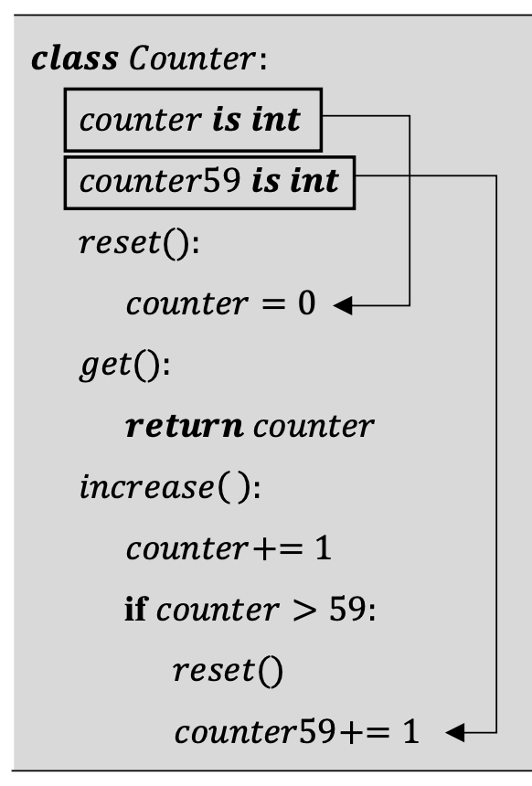
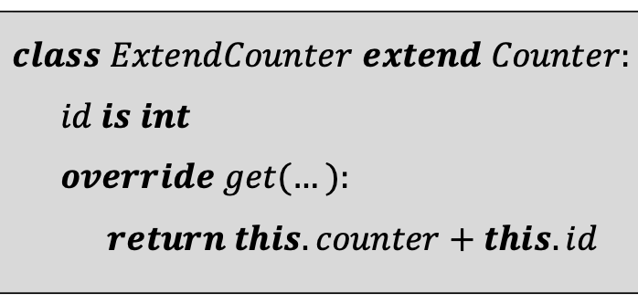
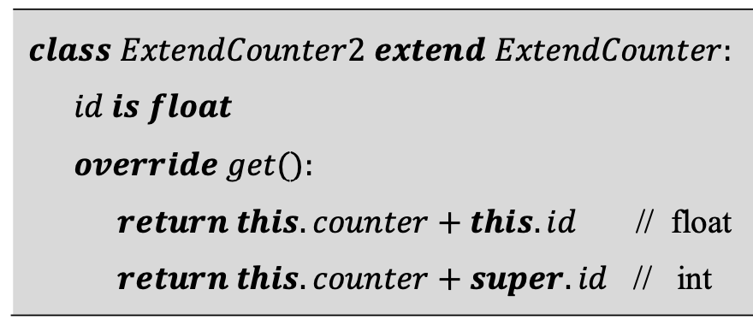
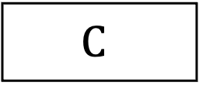
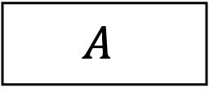
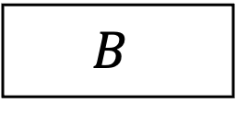
Inheritance (1/4)
$$A$$
Super/Base/Parent class
$$B$$
Sub/Derived/Child
class
$$C$$

Slide 7
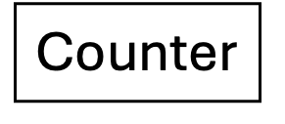
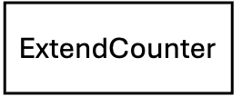
Inheritance (2/4) Override
Counter
Inserted code
ExtendCounter
ExtendCounter2

Slide 8

Inheritance (3/4) Override
$$⇒$$
Inserted code
Overrided
Replace
Override method

Slide 9
Inheritance (4/4) Shadowing
Counter
ExtendCounter
Shadow
ExtendCounter2

Slide 10

Scope (C++) (1/3)
Why we need scope?
Example: Singleton pattern allow only one instance / class.
$$class Hero:$$
$$hero is Hero∗$$
$$private Hero(…)$$
$$getInstance\left(…\right):$$
$$return this→hero== null?$$
$this→hero = new Hero(…)$
$$: this→hero$$
Superclass
Private
Protected
Public
Subclass
Friendclass
???

Slide 11
Scope (C++) (2/3)
class A1:
…
class B extend A1:
…
class A2:
…
class B2:
…
class A3:
…
There are 3 scopes:
Scope of class
Scope of attribute/method
Scope of inheritance
Java
Vertical retrieval
C++
Horizontal retrieval
Does the subclass's member function have the right to access the parent class's components?
Do the components of the parent class, after being inherited down to the subclass, have their access allowed by the outside world through the subclass object?

Slide 12
Scope (C++) (3/3)
Base class | Type of inheritance
 | Public | Protected | Private
Public | Public in derived class. Can be accessed directly by any non-static member functions, friend functions and non-mem­ber functions. | Protected in de­rived class. Can be accessed directly by all non-static member functions and friend functions. | Private in de­rived class. Can be accessed directly by all non-static member functions and friend functions.
Protected | Protected in de­rived class. Can be accessed directly by all non-static member functions and friend functions.
Private | Hidden in derived class. Can be accessed by non-static member functions and friend functions through public or protected member functions of the base class.

Slide 13
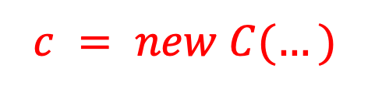
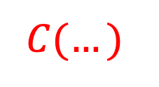



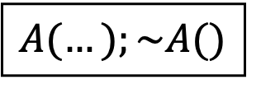
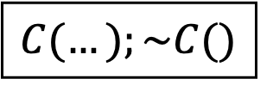
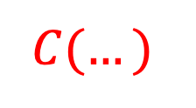


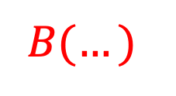
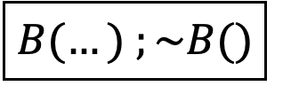

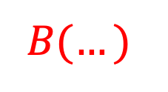
Constructor/Destructor chain (1/2)
Constructor and Destructor methods are automatically called from superclass to subclass and subclass to superclass, respectively.
$$A$$
$$c = new C(…)$$
$$delete c$$
$$A(…);\sim A()$$
$$A(…)$$
$$C(…)$$
$$B$$
$$B(…)$$
$$B(…)$$
$$B(…) ;\sim B()$$
$$C(…)$$
$$A(…)$$
$$C$$
Time
$$C(…);\sim C()$$

Slide 14
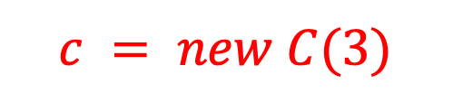
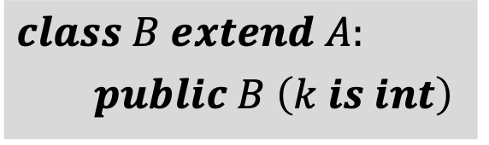
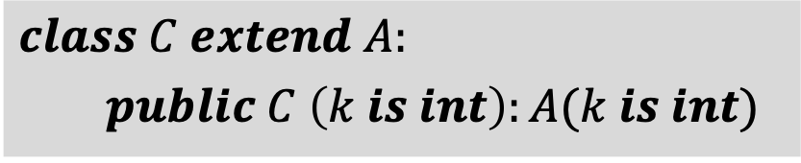
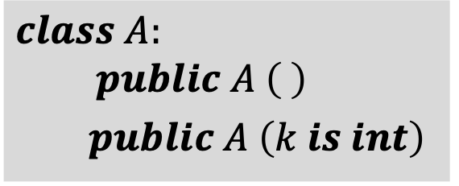
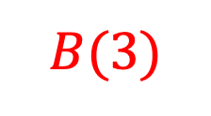

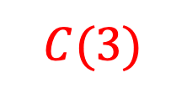
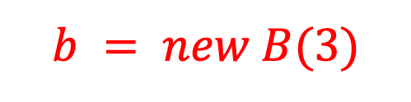
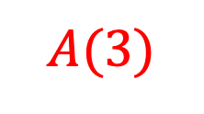
Constructor/Destructor chain (2/2)
If all constructor methods of the base class require parameters, then the subclass must have a constructor method to provide those parameters.
$$class A:$$
$$public A \left( \right)$$
$public A \left(k is int\right)$
$$b = new B(3)$$
$$c = new C(3)$$
$$A( )$$
$$A(3)$$
$$B(3)$$
$$C(3)$$
$$class B extend A:$$
$public B \left(k is int\right)$
Time
Time
$$class C extend A:$$
$public C \left(k is int\right):A(k is int)$

Slide 15


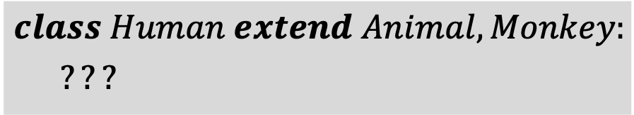
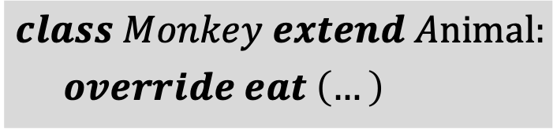
Multiple inheritance (1/2)
Not much languages allow multiple inheritance.
Animal
Pet
$$⇒$$
Got DIAMOND problem
Request for attribute/method is ambiguous
Monkey
Dog
$$class Animal:$$
$$eat \left(…\right)$$
Human
$$class Monkey extend Animal:$$
$override eat \left(…\right)$
$$class Human extend Animal, Monkey:$$
$???$

Slide 16
Bài tập
Viết 4 class HocSinhNam, HocSinhNu, GiaoVien, Nguoi.
Biết rằng người có thuộc tính tên và năm sinh.
Giáo viên có thêm thuộc tính lương
Học sinh nam có thêm thuộc tính chiều cao
Học sinh nữ có thêm thuộc tính cân nặng.
Yêu cầu: implement 4 class này sử dụng kế thừa và viết
Các contrustor/destructor & operator<< / operator >>

Slide 17
Multiple inheritance (2/2)
How to express the independence of attribute/method with the same name within a derived class?
How about constructor/destructor chain?
How to resolve diamond problem?

